Slide 1






WP6 activities
5th Nov, 2019
Annual meeting - Trieste.
JF. Perrin on behalf of the WP6 team.
This project has received funding from the European Union’s Horizon 2020 research and innovation programme under grant agreement No. 823852

Slide 2
The menu
6.1 Management of the Interaction with the EOSC Stakeholders.
-> Participation in EB WG on Architecture (Jean-François) -> EnhanceEOSC (INFRAEOSC-06) (Jean-François)
-> EOSCHub strategic boards (Andy).
6.2 EOSC Service Catalogue.
-> FiTSM Trainings
-> Identify the first service (pilot)
-> Does the current EOSC catalogue model fits our needs?
-> Do we have a vision of our need?
(Dec start of EOSCEnhance project).
6.3 Data availability for the services
-> Next slides

Slide 3
The menu
6.4 AAI.
-> Next slides
6.5 Services Support (M12-M48).
-> How do we want to organise the support of the federated services
6.6 PaN Software catalogue ( M12-M36)
-> Ignite discussion on new functionalities
-> https://software.pan-data.eu/
6.7 Data archiving pilot (M12-M48).

Slide 4
Data availability for services – Data transfer
3 use cases :
Facility users want to transfer the data to their home PC/Lab
Potential solutions: Globus Online, … (ELI)
Archiving uses case: How to transfer data from a production RI to external cold storage (STFC and ILL)
GridFTP, …
Transfer of data to Analysis Services
Scenario: a user wants to perform analysis using an analysis service provided by another organisation than the RI (i.e: EGI Jupyter notebook)

Slide 5
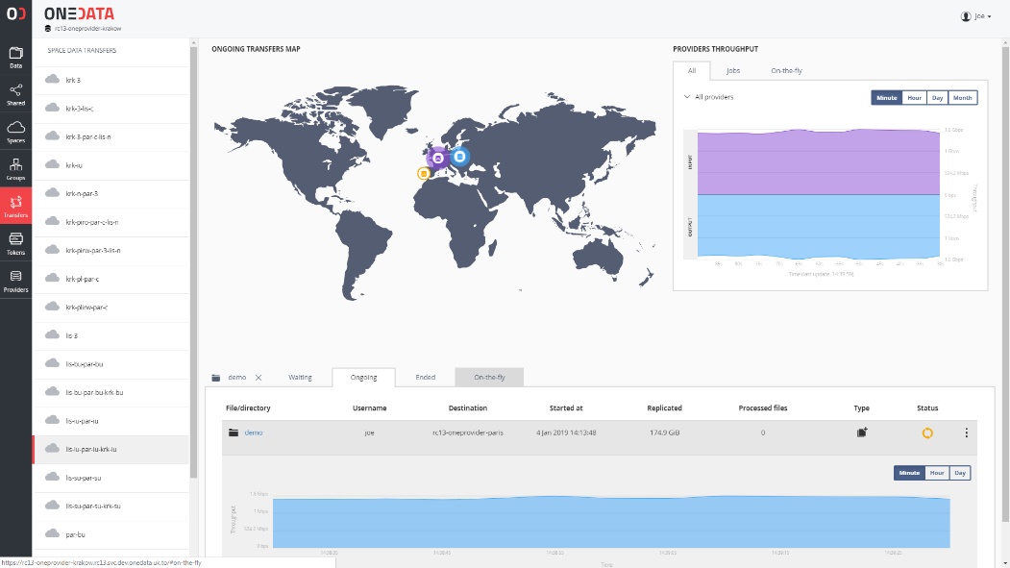
Data availability for services – Data transfer
Transfer of data to Analysis Services
OneData (CERIC as RI, EGI/Cesnet hosting the services)
Aggregate data from different sources
Local cache
AAI and ID translation
REST APIs
…

Slide 6
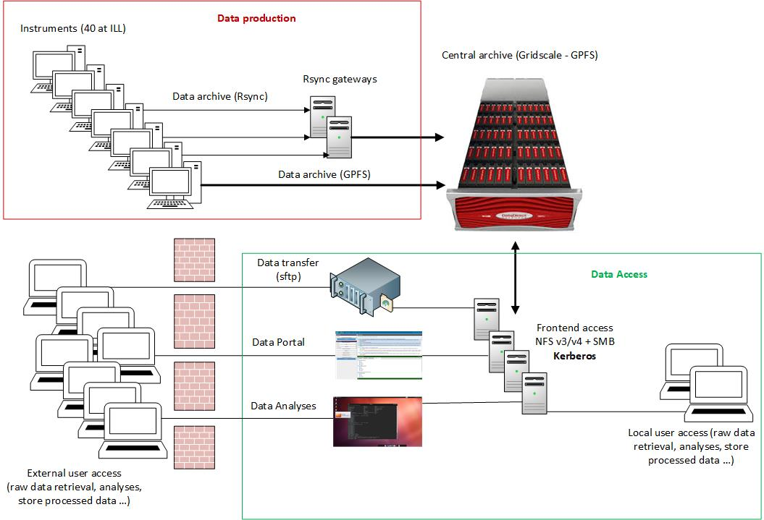
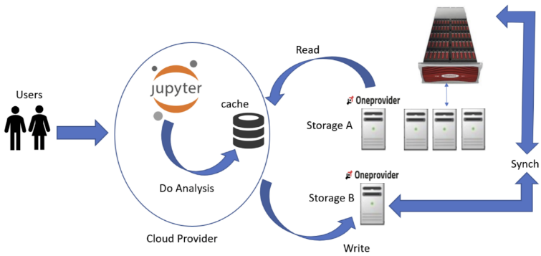
Data availability for services – Data transfer
Transfer of data to Analysis Services
dCache (ILL as RI, DESY hosting the services)
Local cache
AAI and ID translation
…

Slide 7
AAI. (M1-M36)
PaNOSC + National RIs + GÉANT
Study the feasibility, potential impacts and sustainability of the possible models for integrating the Photon and Neutron AAI with EOSC.
Present, discuss and reach agreement inside the Photon and Neutron facility community at large (the PaNOSC partners and other members of the AAI consortium) on the integration of the PaNOSC AAI infrastructure, delivered with GÉANT, into EOSC.
Implement this integration at the level of the Identity providers (IdP).
Provide solutions and documentation for the integration into the different services that PaNOSC is providing.

Slide 8
AAI.
Sept 2018: Specification sent to GÉANT
Nov 2018 – May 2019: Mutual understanding
June 2019: Presentation at the PSI annual Umbrella Meeting
July 2019: Agreement from the Umbrella partners
Sept 2019: Infrastructure is opened
Nov – Dec 2019: Scope/claims definition, Migration, Extra functionalities

Slide 9
UmbrellaID.org
Facts
Started out in 2012 as a collaboration between the main European analytical user facilities in the field of research using photons and neutrons (PaN facilities)
Over 1500 users providing services to 16 European organisation
Objectives
Provide a common Authentication and Authorization Infrastructure that allows users of all PaN facilities to connect seamlessly to digital facility services with a single and unique ID.
Authorization should remain in full control of each facility providing the services
Users should be in full control of their personal data

Slide 10
UmbrellaID.org | Goals in PaNOSC
Increase capacity to respond to users’ needs in a stable, secure and trusted environment
Cater from the growing security constraints and legal requirements
Global and comprehensive interoperability with services outside of the Photon and Neutron domain
Access to the European Open Science Cloud

Slide 11
Requirements 1/2
EOSC integration
Currently users can link their eduGAIN account with their umbrellaID account, allowing them to retain a single account. We need to go further and allow a complete interoperability with EOSC services in term of access, support and security.
Security policies
Policies regarding password changes, audit and user vetting must be introduced. Two factors of authentication should be proposed to the users. It is necessary to look at security issues at a global level and participate in international efforts
Attributes
We need to extend the set of attributes (e.g. email address) in a full compliance with the different regulations regarding personal data protection.

Slide 12
Requirements 2/2
Operation
The current operations of the IdPs are supported by a team of 2 engineers not solely dedicated to this task. We need to extend the support team in order to have a constant cover and surveillance of the services operations
Innovation
FIM and authentication technologies are constantly evolving; we would like to be at the forefront with these advancements. This would be easier to achieve in a context of a larger technical collaboration. Support for OIDC, REST APIs, non-web services
Training and Service Support
FIM technologies are still relatively complex and demand specific training and support, especially for the service providers’ engineers in order to enable the rapid growth of the number of services in a secure environment.

Slide 13

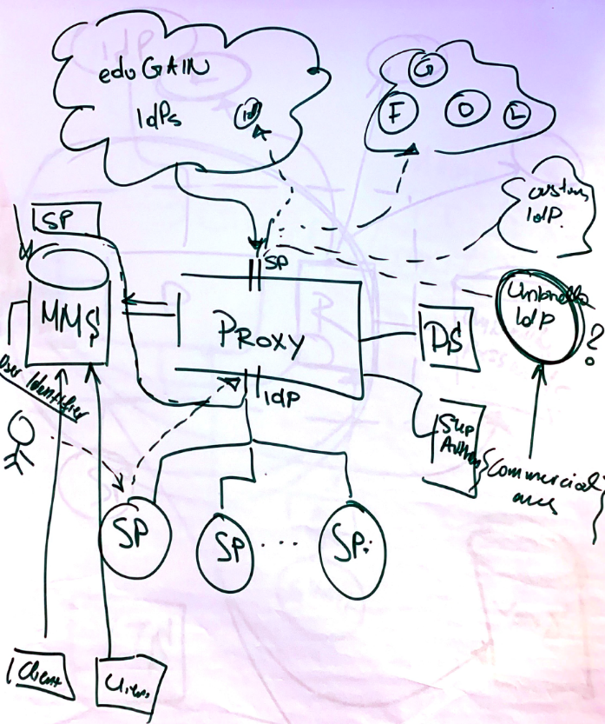
PaNOSC AAI
Notes:
Full implementation of BPA –

Slide 14
AAI. What does it mean for you now
SAML + OAUTH + OpenIDConnect (OIDC) + X509 (if necessary)
Attributes++ :
EAAHash
Research and Scholarship Entity Category
https://refeds.org/wp-content/uploads/2016/09/ENTCAT-RANDS-v1.3.pdf
Name, email, Affiliation …
ORCID (If any)
Support and training

Slide 15
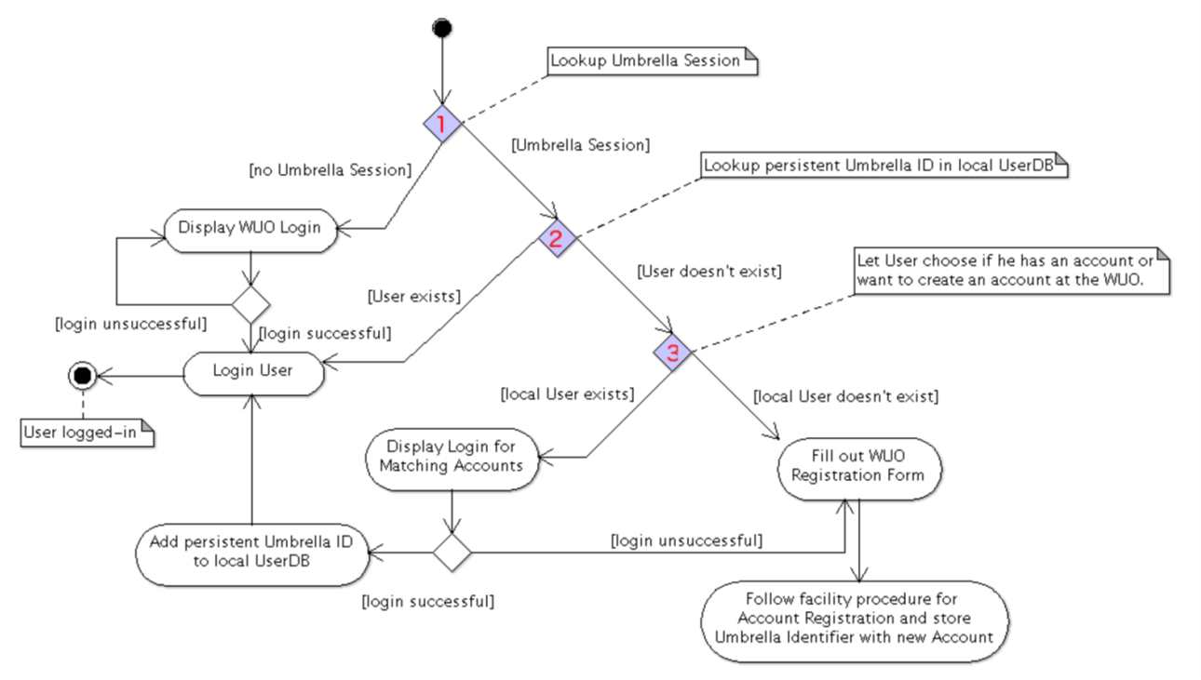
AAI. Authorisation models
Simple case: direct use of the attributes provided for authorisation
-> Probably sufficient for open data (if you want to register the download)
Translation to local ID
(Facility ID) and
Authorisations
-> Standard use case

Slide 16
PaNOSC AAI
Membership Management services
VO specific workflows for onboarding members
Registry for user persistent Identifiers
Support for R&S attributes to maximize interoperability
Use of eduPersonEntitlement(s) to express groups, roles and Service Entitlements
Choice between COmanage, HEXAA and Perun

Slide 17
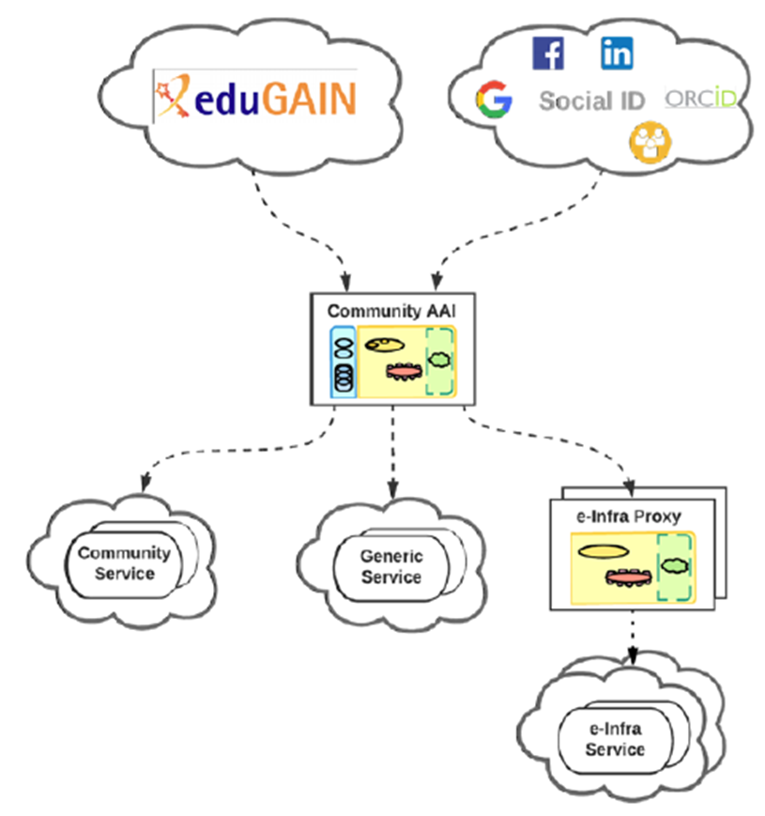




AAI. EOSC interoperability
Work in progress with EGI and GÉANT
Data archives at RI
This project has received funding from the European Union's Horizon 2020 research and innovation programme under grant agreement No 823852

Slide 18
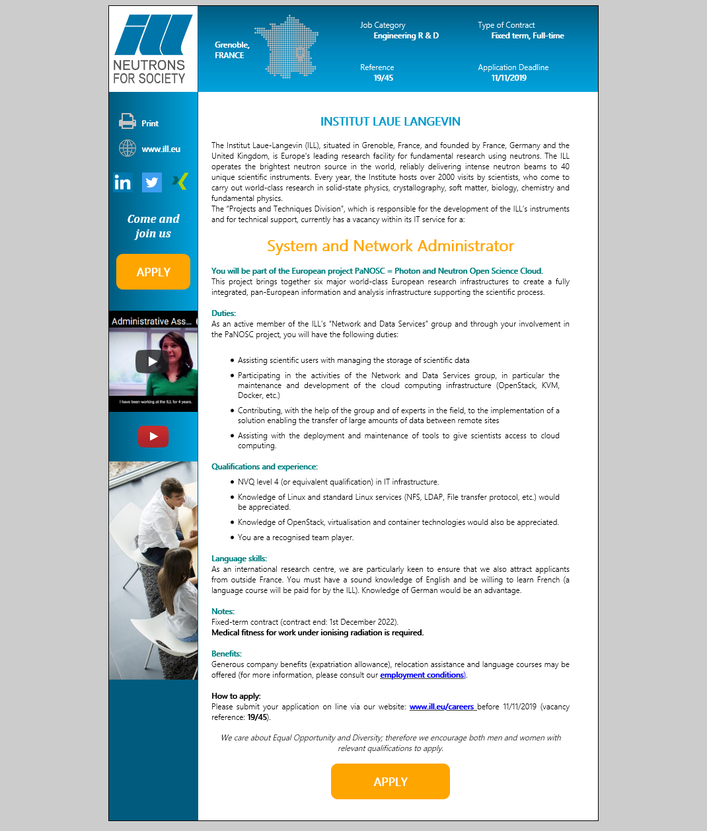
Current challenges
Position continuously opened since 1 year.
Pilots are running
Deployments are coming
New activities are starting (EOSC Catalogue, Software catalogue)
Decisions have to be understood or even better made together.
Urgent need for an increased RI participation (at least in fortnightly telcos).

Slide 19
We are not alone
Snapshots of unique X-Ray & Neutron scattering users, over 18 months (2013 – 2014).

